Slide 1
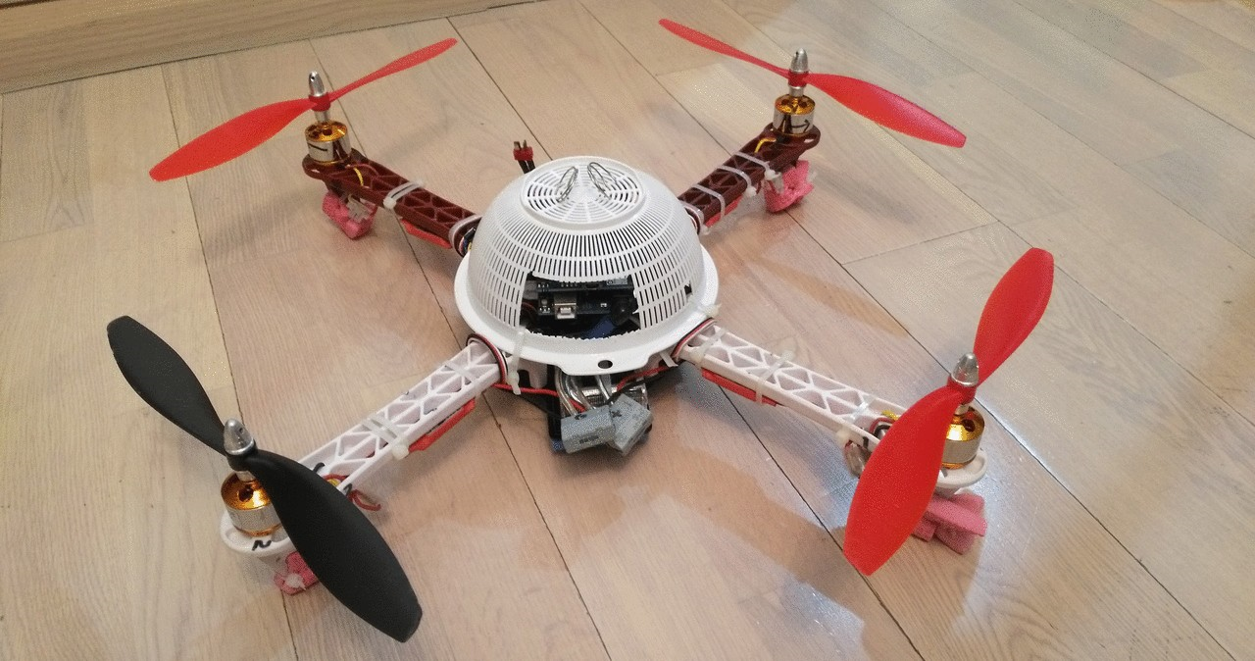
Android Arduino quadcopter
Presented By:
Codemy gamma
Saurav
Rohit
Devashish
Sparsh

Slide 2

Introduction
Project Overview
The purpose of this project is to create a quadcopter that can be controlled by user input sent over the phone’s wifi connection . Furthermore, the purpose is also to be able to receive live video feedback over the internet connection , thus making it an inexpensive option compared to other equivalent drones. Android’s other features such as GPS, picture taking, data storage, networking etc. can also be added .
Ultimately, this project is intended to give a cost effective means of adding numerous potential features to a standard quadcopter.

Slide 3
Project Goals And Objectives:
The project objective is to work on the concepts of product innovation, project-based learning, multidisciplinary working relationships, improving language proficiency and knowledge of technology and trends.
The main motive of this project is to allow a user to remotely control and fly a quadcopter and receive feedback via the phone.

Slide 4
Hardware
Arduino Uno
Node MCU
DJI F450 frame
Gyro+accelerometer combo board MPU6050
30A ESC with SimonK firmware
A2212 1000KV brushless outrunner motor
10x4.5" propellers
LiPo battery 11.1V , 30C

Slide 5
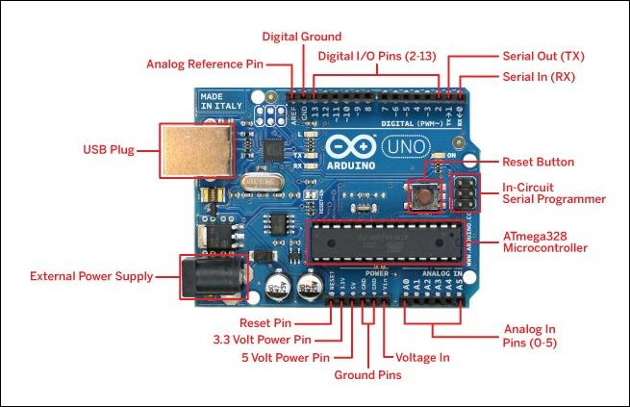
Arduino uno
The Arduino UNO is an open-source microcontroller board based on the Microchip ATmega328P microcontroller and developed by Arduino.cc.The board is equipped with sets of digital and analog input/output (I/O) pins that may be interfaced to various expansion boards (shields) and other circuits.
Specifications
Microcontroller: Microchip ATmega328P
Operating Voltage: 5 Volts
Input Voltage: 7 to 20 Volts
Digital I/O Pins: 14 (of which 6 provide PWM output)
Analog Input Pins: 6
DC Current per I/O Pin: 20 mA
DC Current for 3.3V Pin: 50 mA
Clock Speed: 16 MHz

Slide 6
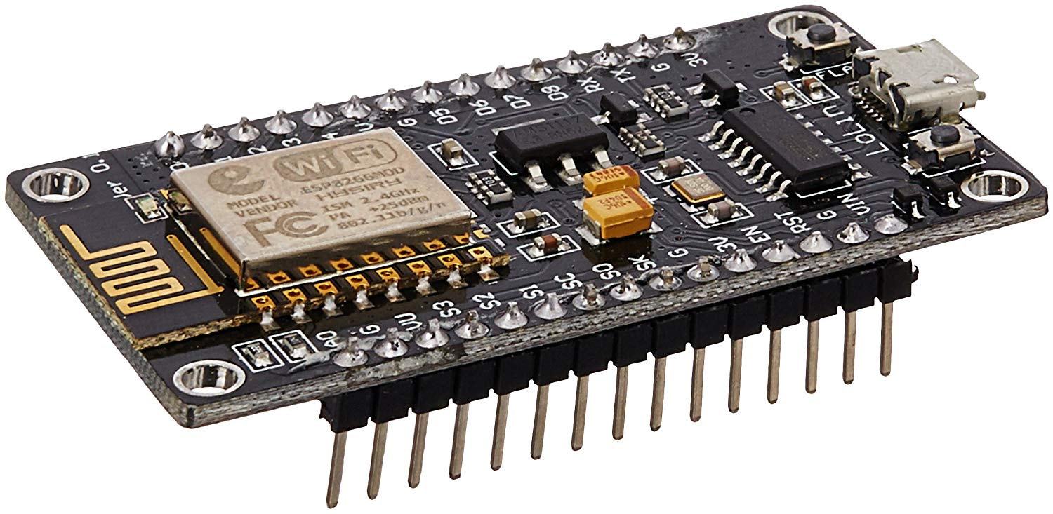
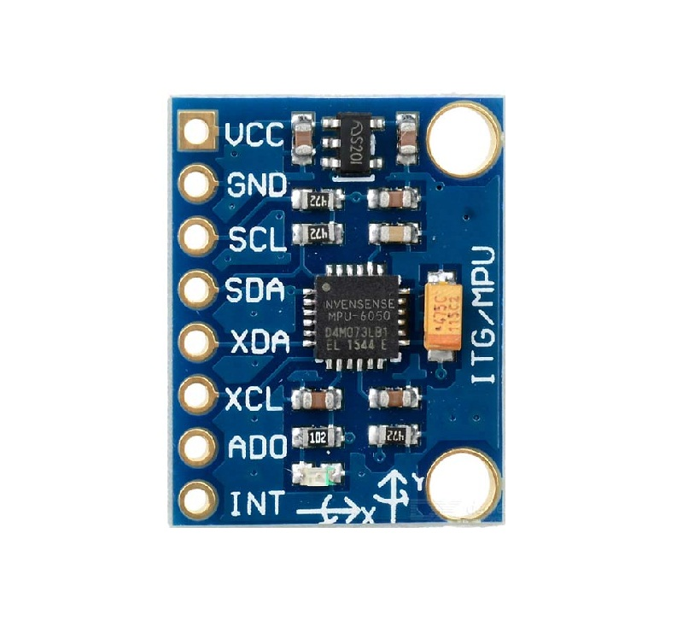
Node MCU
NodeMCU is an open source IoT platform. It includes firmware which runs
on the ESP8266 Wi-Fi SoC from Espressif System, and hardware which is
based on the ESP-12 module.it is used to establish the connection
between the quad and the android device.
MPU6050
The MPU6050 is six-axis IMU sensor.IT has an embedded 3-axis MEMS
gyroscope, a 3-axis MEMS accelerometer. It works on I2c interface. This
small module integrate the logic level converter circuit（makes it
compatible with 3.3V-5V voltage level) together with the MPU6050 sensor.
It is useful in motion detecting.

Slide 7
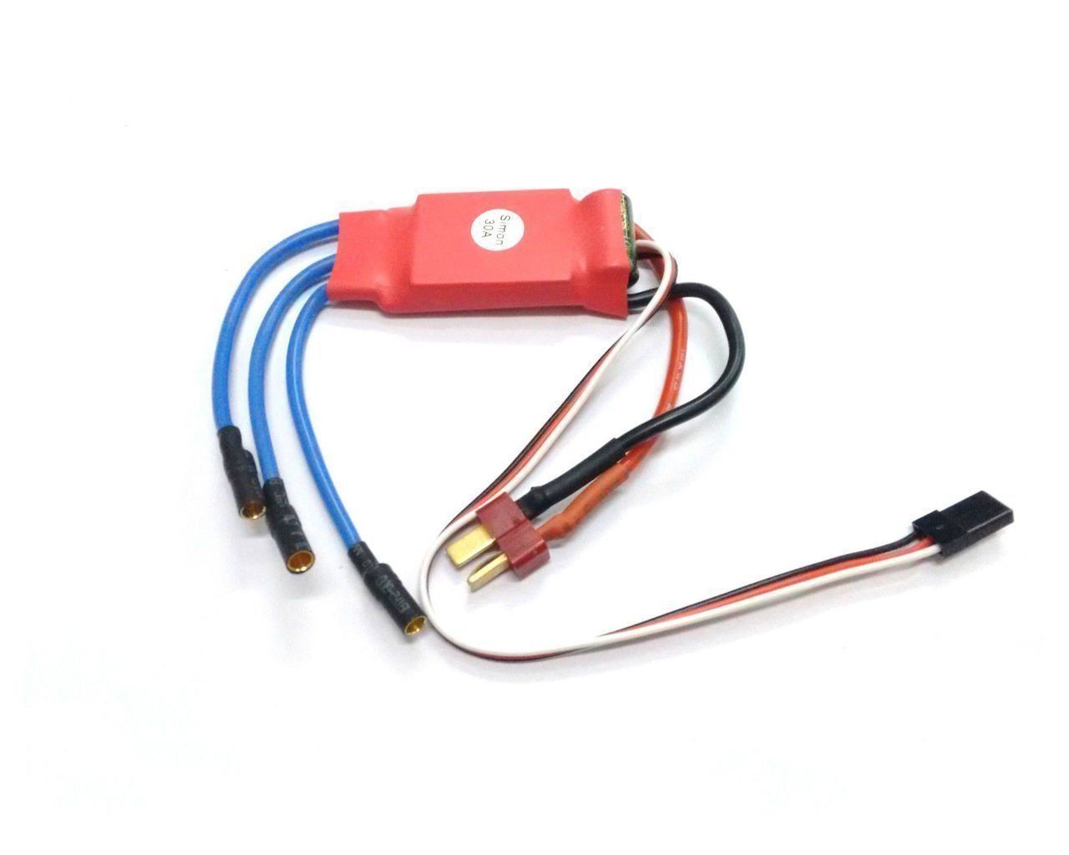
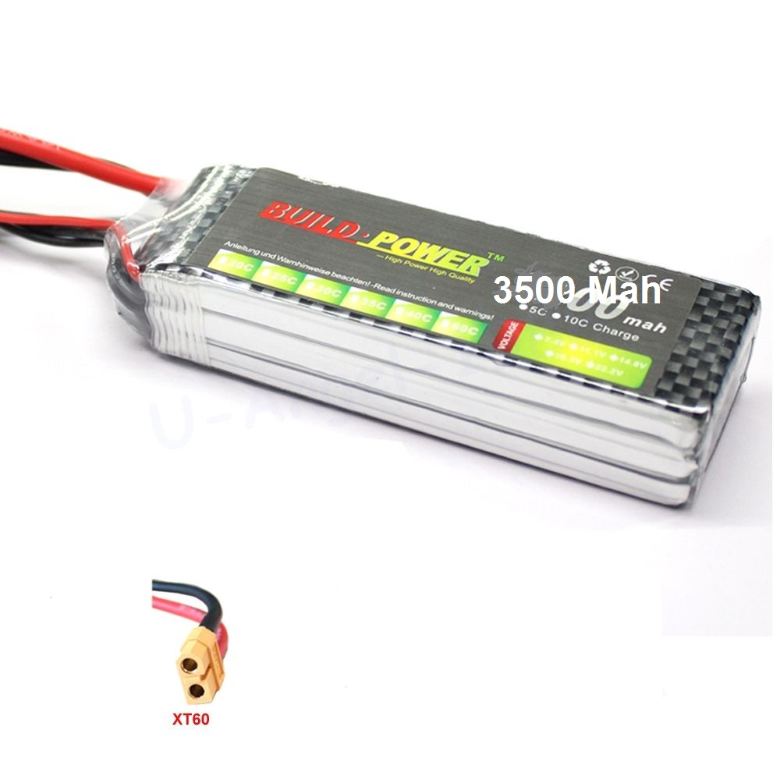
Electronic Speed Control
An electronic speed control or ESC is an electronic circuit that controls and
regulates the speed of an electric motor. It may also provide reversing of the
motor and dynamic braking. It provides PWM signal to the motors in the
range (1000 to 2000).Modern ESC provide Battery Eliminator Circuit(BEC),
which provides 5V output to run microcontrollers thus, eliminating the use
of an extra battery to power the microcontrollers.
Lithium Polymer Battery
It is a 3500mah re-chargable battery which is being used to
supply power to the system.
It is a packet of 3 Li-po cells having 3.7V each with
the total output of 11.1V

Slide 8
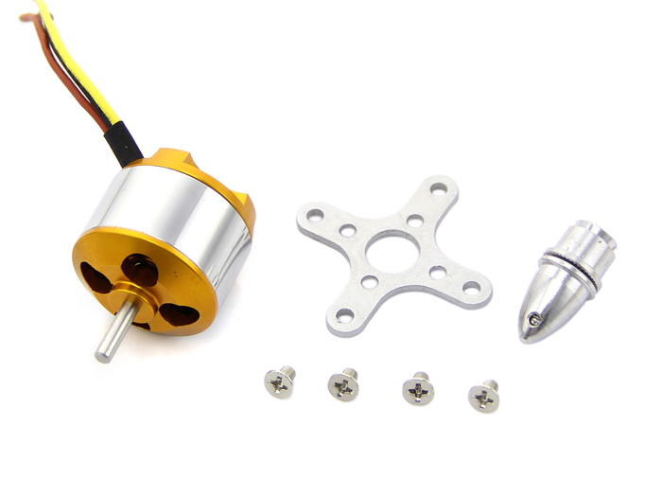
BRUSHLESS OUTRUNNER MOTORS
A brushless DC electric motor (BLDC motor or BL motor), also known as electronically commutated motor (ECM or EC motor) and synchronous DC motors. These are synchronous motors powered by DC electricity via an inverter or switching power supply which produces an AC electric current to drive each phase of the motor via a closed loop controller. The controller provides pulses of current to the motor windings that control the speed and torque of the motor.

Slide 9
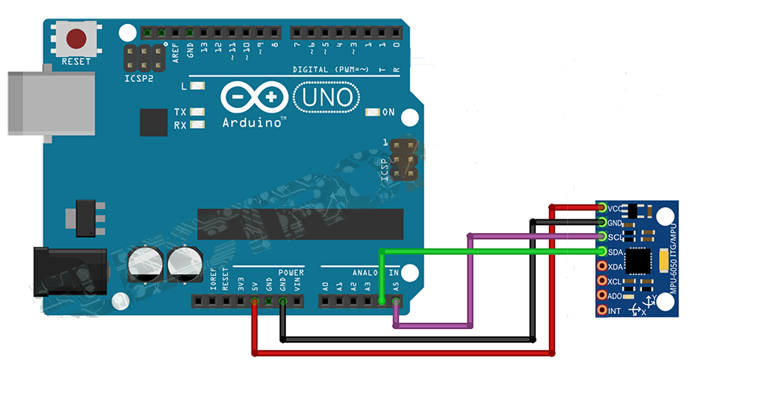
Circuit Connection
1)Arduino with MPU6050
Arduino | MPU6050
3.3V | 3.3V
GND | GND
A4 | SDA
A5 | SCL

Slide 10
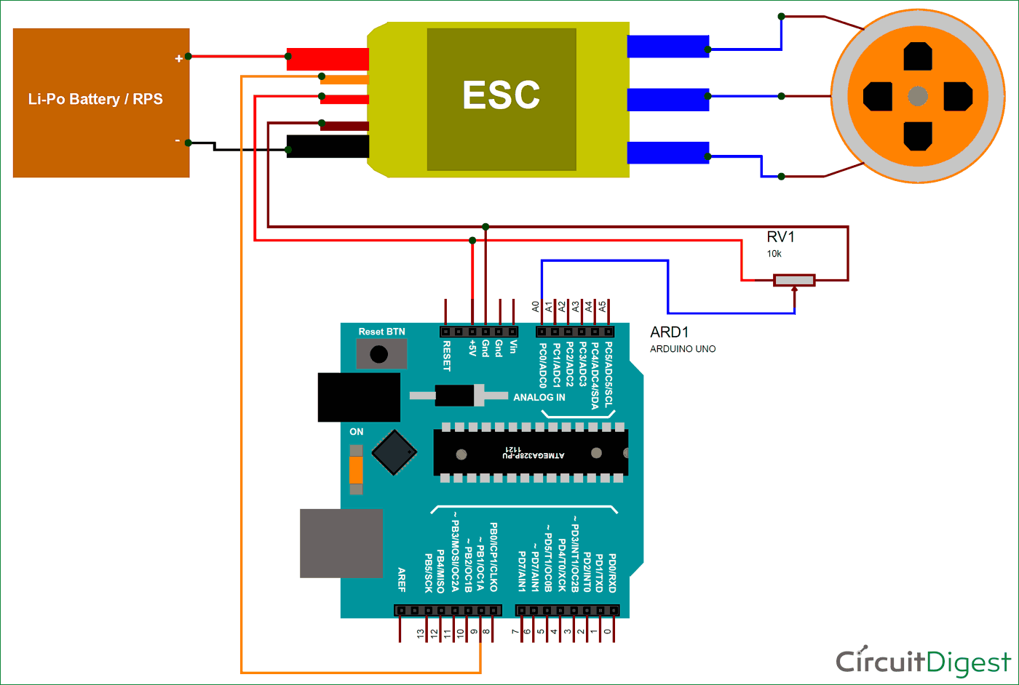
2) Arduino with ESC
Arduino | ESC
Vin | BEC Gnd
Vin | BEC Live
9 | Signal
NOTE : Only one BEC is enough to power Arduino Uno. BEC of other ESC be left as it is.

Slide 11
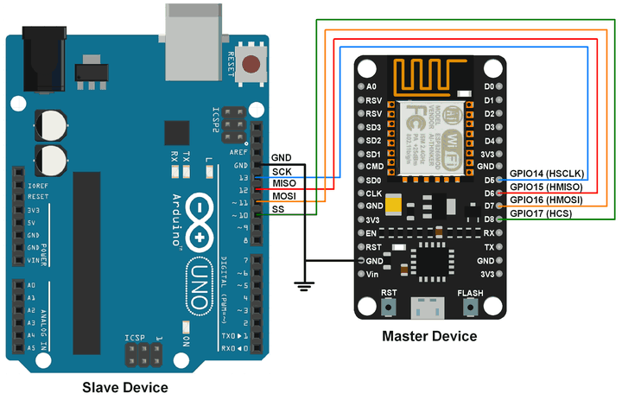
3)Arduino with Node MCU
Arduino | Node MCU
GND | GND
D13 | D5
D12 | D6
D11 | D7
D10 | D8

Slide 12
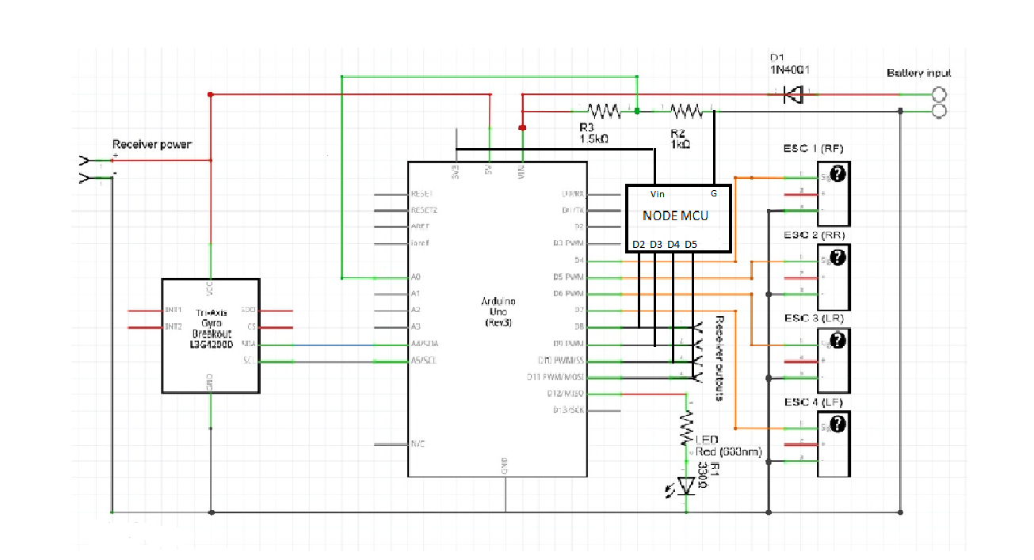
SCHEMATIC CIRCUIT CONNECTION

Slide 13
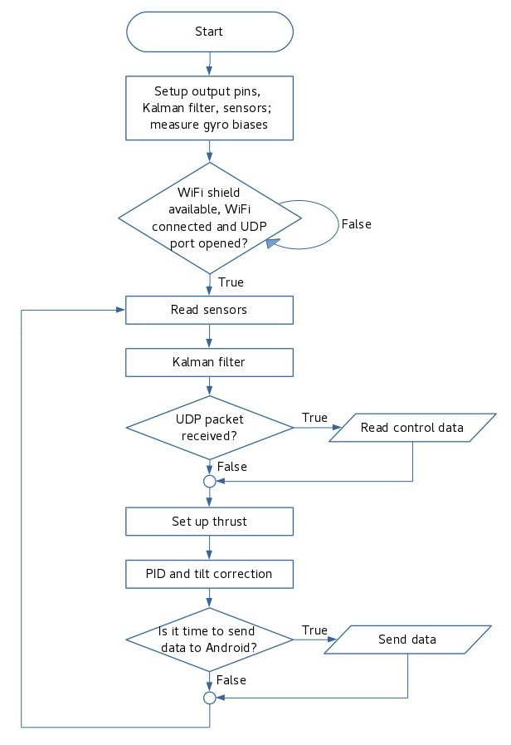
WORKING
Sensor reading part is relatively easy: some parameters must be set in the beginning and then new values are read in each iteration. A bit of confusion is there because accelerometer measures in radians and gyro in... 14.375 degrees/s. So some math and trigonometrical transformations required to convert them to degrees. Good explanation as well as a good idea of measuring gyro bias and subtracting it from subsequent readings are here. Best source of information, of course, MPU6050 chipset datasheets.

Slide 14
Kalman filter was the most difficult and time consuming part. That filter is what makes gyro and accelerometer angular readings usable. You can't use accelerometer because it's very (no, VERY!) noisy - with running motors and propellers attached its readings just look like a nonsense, white noise. Gyro can't be used alone because it measures rate of change, not the angle itself, so you never know it (summing up (integrating) its readings to determine the angle won't work - even though gyro is much more precise than accelerometer, cumulative effect of summing up its small errors will make that angle determination unusable in seconds). Kalman filter uses physical model (kinematic equations in this case) and these two sensors to calculate the approximate value of angle.
The difficulties one can have:
sending output PWM signal by changing Arduino registers directly.
different ESC settings and tons of re-calibrations
different ESC vendors
at some point I even measured Arduino's output PWM signal by oscilloscope to ensure it's the same on all 4 ESCs
complementary filter

Slide 15
A proportional–integral–derivative controller (PID controller. or three-term controller) is a control loop feedback mechanism widely used in industrial control systems and a variety of other applications requiring continuously modulated control. A PID controller continuously calculates an error value as the difference between a desired setpoint (SP) and a measured process variable (PV) and applies a correction based on proportional, integral, and derivative terms (denoted P, I, and D respectively), hence the name.
PID is what makes use of Kalman filtered sensor data to stabilize the drone's position. Thrust for each motor is calculated based on the difference between Android's and drone's pitch and roll (or, more specifically, difference, rate of difference's change and cumulative difference).
It is much easier than Kalman, although still requires time and testing to find right P, I and D values.

Slide 16
SCOPE
The pace of change in today’s world is mandating that we produce a faster smarter and better grade of technologies. So, the scope and expectation from our project is quiet high. There are numerous features that can be implemented in this project. Technologies such as telemetry for mission planning, object detection, infrared sensor and ultrasound sensor for collision avoidances, night vision, live photography, tracking ie, acting as a flying police eye can be added.
Moreover, this project can also be used for delivery system. Nowadays several companies advances in drone delivery have been well publicized. The biggest name in this emerging space is online retail giant Amazon. Drones apart from this can also be useful for Discriminatory targeting ie, it can discriminate the right and the wrong person and hence automatically alarms when the wrong guy is being detected. Also it can be used in farming .
The most interesting part for futuristic scope is video augmentation through deep learning. This technology is quiet high as it can allow the user to see through imaging.
Therefore first our main motive is to complete this project of quadcopter and then we will work on different technologies that can foster human needs, be useful in various fields and can make a helping hand towards advancement in today’s world.

Slide 17
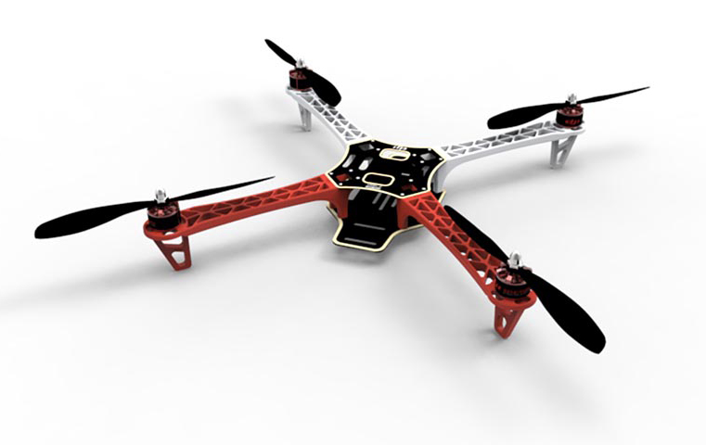
Thank you

